Slide 1
Mobile Computing
Dr. Hany El-Ghaish

Slide 2
Outline
What is Mobile Computing ?
Functions of Mobile Computing.
Logical Division of MC Functions.
Networks in Mobile Computing.
Generations of the Mobile Services.
Cellular Networks.

Slide 3
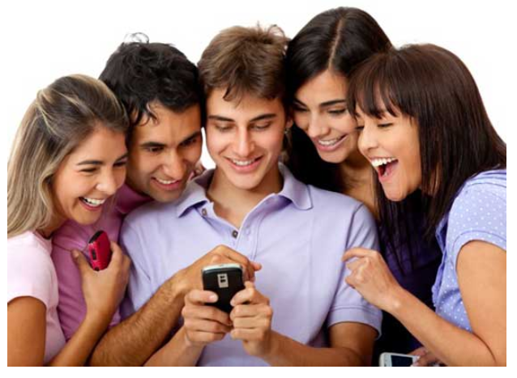
Mobile Computing - Brief Evolution
In today's computing world, different technologies have emerged. These have grown to support the existing computer networks all over the world. With mobile computing, we find that the need to be confined within one physical location has been eradicated.
We hear of terms such as telecommuting, which is being able to work from home or the field but at the same time accessing resources as if one is in the office.

Slide 4
Mobile Computing - Brief Evolution
The advent of portable computers and laptops, Personal Digital Assistants (PDA), PC tablets and smartphones, has in turn made mobile computing very convenient.
The portability of these devices ensure and enable the users to access all services as if they were in the internal network of their company.
For example, the use of Tablet PC and iPads. This new technology enables the users to update documents, surf the internet, send and receive e-mail, stream live video files, take photographs and also support video and voice conferencing.

Slide 5
Mobile Computing
Mobile Computing (MC) is a technology that allows transmission of data, voice and video via a computer or any other wireless enabled device without having to be connected to a fixed physical link.
The main concept of MC involves :
Mobile communication
Mobile hardware
Mobile software

Slide 6
Mobile Computing
MC discusses how to connect mobile devices with other electronic devices while on move.
MC is a technology allows tx of data, voice, and video without any physical links among any other wireless enabled devices (Computer, laptop, mobile, etc.)
Mc is using a computer while on the move. It means that you are using your mobile while roaming from one place to another.
MC is the ability to compute remotely while on the move from one place to another (any where and at any time).
MC is the ability to access data anywhere and any time.

Slide 7
Main Concepts of MC
The main concepts of Mobile Computing involves:
Mobile Communication
Mobile Hardware
Mobile Software
Mobile communication means if you want to connect from one device to another how the data is communicating.
With the help of service providers
Your system (for sending and receiving data, voice, and calls)
Mobile HW and Mobile SW
Different equipment will be used and communicate with each other
Different SW (Operating system in each mobile)
Different SW applications will be installed

Slide 8
Mobile communication
The mobile communication in this case, refers to the infrastructure put in place to ensure that seamless and reliable communication goes on.
These would include devices such as protocols, services, bandwidth, and portals necessary to facilitate and support the stated services.
The data format is also defined at this stage. This ensures that there is no collision with other existing systems which offer the same service.
Since the media is unguided/unbounded, the overlaying infrastructure is basically radio wave-oriented. That is, the signals are carried over the air to intended devices that are capable of receiving and sending similar kinds of signals.

Slide 9
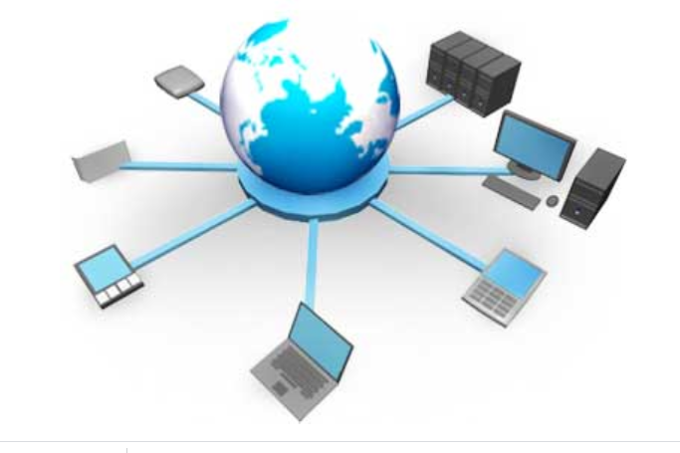
Mobile communication

Slide 10
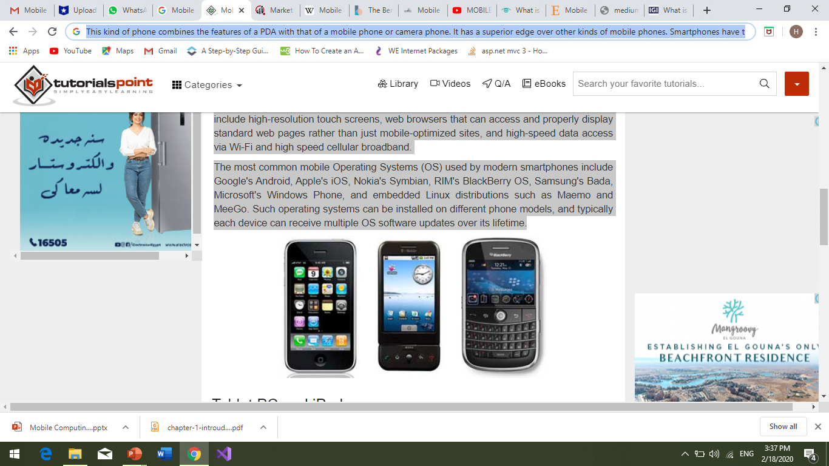
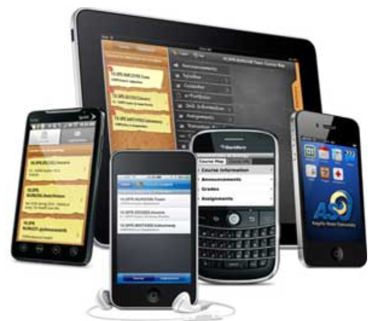
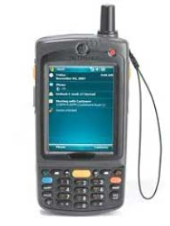
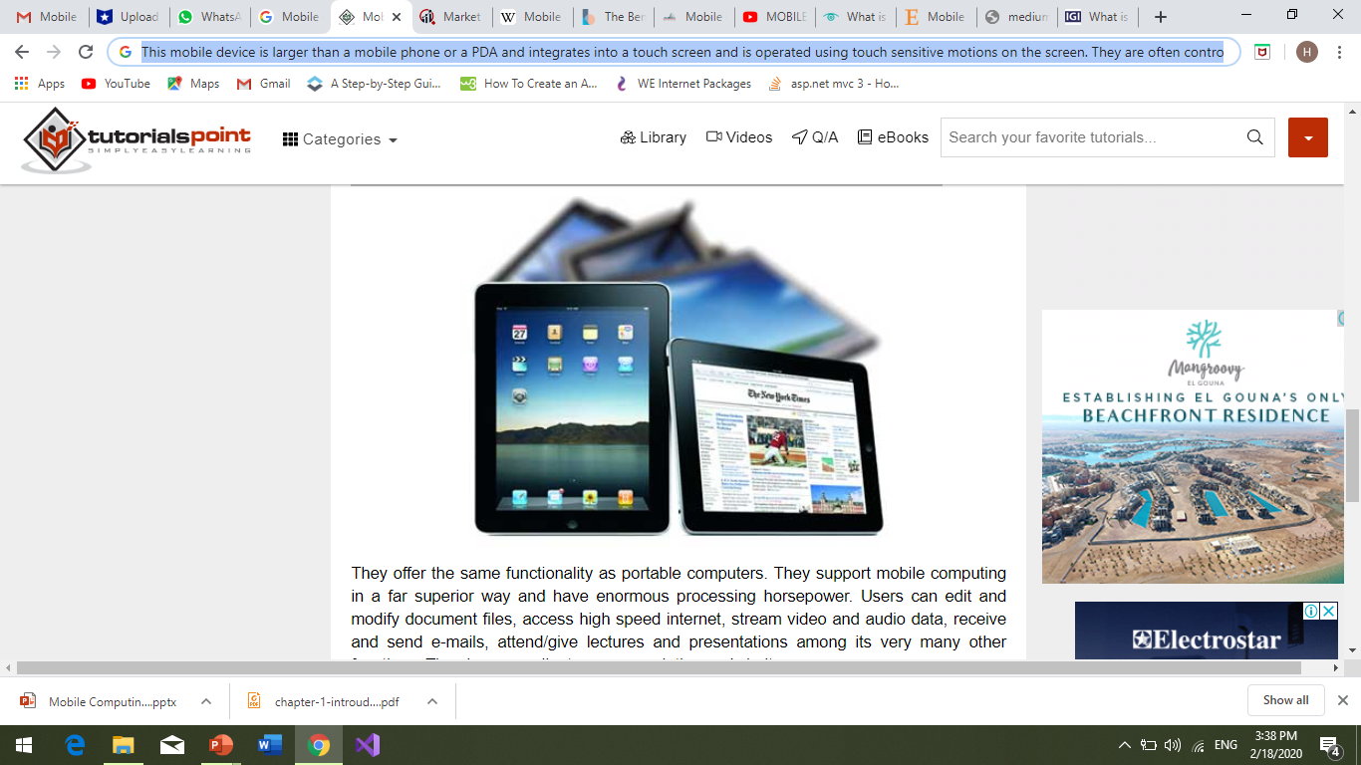
Mobile Hardware
Mobile hardware includes mobile devices or device components that receive or access the service of mobility. They would range from portable laptops, smartphones, tablet Pc's, Personal Digital Assistants.

Slide 11
Mobile Hardware
These devices will have a receptor medium that is capable of sensing and receiving signals. These devices are configured to operate in full- duplex, whereby they are capable of sending and receiving signals at the same time. They don't have to wait until one device has finished communicating for the other device to initiate communications. Above mentioned devices use an existing and established network to operate on. In most cases, it would be a wireless network.

Slide 12
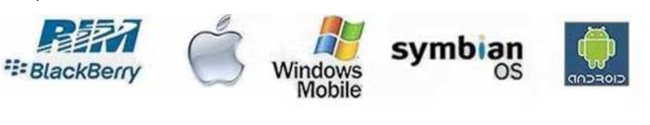
Mobile software
Mobile software is the actual program that runs on the mobile hardware. It deals with the characteristics and requirements of mobile applications. This is the engine of the mobile device. In other terms, it is the operating system of the appliance. It's the essential component that operates the mobile device.
Since portability is the main factor, this type of computing ensures that users are not tied or pinned to a single physical location, but are able to operate from anywhere. It incorporates all aspects of wireless communications.

Slide 13
Mobile Computing - Advantages
Location Flexibility
This has enabled users to work from anywhere as long as there is a connection established. A user can work without being in a fixed position. Their mobility ensures that they are able to carry out numerous tasks at the same time and perform their stated jobs.
Saves Time
The time consumed or wasted while travelling from different locations or to the office and back, has been slashed. One can now access all the important documents and files over a secure channel or portal and work as if they were on their computer. It has enhanced telecommuting in many companies. It has also reduced unnecessary incurred expenses.
Enhanced Productivity:
Users can work efficiently and effectively from whichever location they find comfortable. This in turn enhances their productivity level.

Slide 14
Mobile Computing - Advantages
Ease of Research
Research has been made easier, since users earlier were required to go to the field and search for facts and feed them back into the system. It has also made it easier for field officers and researchers to collect and feed data from wherever they are without making unnecessary trips to and from the office to the field.
Entertainment
Video and audio recordings can now be streamed on-the-go using mobile computing. It's easy to access a wide variety of movies, educational and informative material. With the improvement and availability of high speed data connections at considerable cost, one is able to get all the entertainment they want as they browse the internet for streamed data.
Streamlining of Business Processes
Business processes are now easily available through secured connections. Looking into security issues, adequate measures have been put in place to ensure authentication and authorization of the user accessing the services.
Some business functions can be run over secure links and sharing of information between business partners can also take place.
Meetings, seminars and other informative services can be conducted using video and voice conferencing.
Travel time and expenditure is also considerably reduced.

Slide 15
Mobile Computing - Security Issues
Mobile computing has its fair share of security concerns as any other technology. Due to its nomadic nature, it's not easy to monitor the proper usage. Users might have different intentions on how to utilize this privilege. Improper and unethical practices such as hacking, industrial espionage, pirating, online fraud and malicious destruction are some but few of the problems experienced by mobile computing.
Another big problem plaguing mobile computing is credential verification. As other users share username and passwords, it poses as a major threat to security. This being a very sensitive issue, most companies are very reluctant to implement mobile computing to the dangers of misrepresentation.
The problem of identity theft is very difficult to contain or eradicate. Issues with unauthorized access to data and information by hackers, is also an enormous problem. Outsiders gain access to steal vital data from companies, which is a major hindrance in rolling out mobile computing services.
No company wants to lay open their secrets to hackers and other intruders, who will in turn sell the valuable information to their competitors. It's also important to take the necessary precautions to minimize these threats from taking place. Some of those measures include −
Hiring qualified personnel.
Installing security hardware and software
Educating the users on proper mobile computing ethics
Auditing and developing sound, effective policies to govern mobile computing
Enforcing proper access rights and permissions

Slide 16
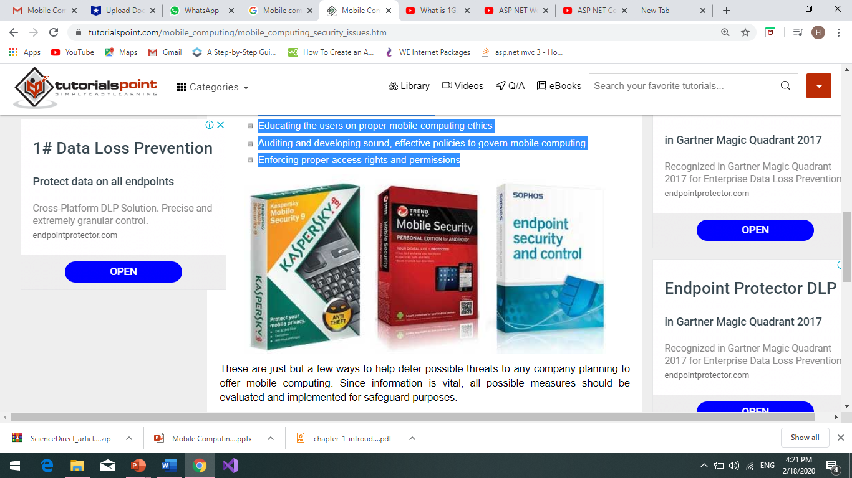
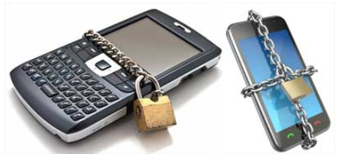
Mobile Computing - Security Issues
These are just but a few ways to help deter possible threats to any company planning to offer mobile computing. Since information is vital, all possible measures should be evaluated and implemented for safeguard purposes. In the absence of such measures, it's possible for exploits and other unknown threats to infiltrate and cause irrefutable harm. These may be in terms of reputation or financial penalties. In such cases, it's very easy to be misused in different unethical practices. If these factors aren’t properly worked on, it might be an avenue for constant threat. Various threats still exist in implementing this kind of technology.

Slide 17
Mobile Computing Main Functions
User Mobility.
Network Mobility
Bearer Mobility
Device Mobility.
Session Mobility.
Service Mobility
Agent Mobility
Host Mobility

Slide 18
Mobile Computing Functions
1. User mobility: User should be able to move from one physical location to another location and use same service 2. Network mobility: User should be able to move from one network to another network and use same service 3. Device mobility: User should be able to move from one device to another and use same service 4. Session mobility: A user session should be able to move from one user-agent environment to another. 5. Service mobility: User should be able to move from one service to another. 6. Host mobility: The user should be either a client or server.

Slide 19
Mobile Computing Main Functions
The main functions (Characteristics) of MC - Why are we using MC?
User Mobility:
The user can move from one physical location to another and uses the same services.
Services (Network Hardware and a Software or remote NK hardware)
A mobile device has a set of hardware that has the mobility features.

Slide 20
Mobile Computing Main Functions
Network Mobility
MC is a network Mobility: It means from one country to another country, you can receive the data, voice, video.
Because of N/W mobility you can access any mobile device in another country,
Bearer Mobility:
It means, User should move from bearer to another bearer and then uses the same services.
Bearer are service providers.
Ex. Move from Cairo → Alex
In Cairo, You have a wireless Application Protocol (WAP) for (Voice, SMS, Audio) at your home network.
In Alex, the WAP is not supported
In this case the Bear Mobility guarantee that the bearer (Service Provider) enables access to the same application even if the WAP is not supported

Slide 21
Mobile Computing Main Functions
Device Mobility:
Your mobile is a device mobility, it means that whatever the network you are using , it should support the device mobility.
Mobile is working as a computer when you are in your home and works as another device in another location.
User should be able to move from one location to another and use the same service. Ex. You can access your applications and data from everywhere at any time
Session Mobility:
The user session should be moved from one user agent and mirrored to another agent environment.
Ex CDMA N/W if this network is turned off for some reason and again restarted. The session is suspended while the CDMA N/W will continues (disconnect then connected).
Car → CDMA session with mobile then → Disconnect → resume CDMA session from desktop computer
CDMA: Code Division Multiple Access

Slide 22
Mobile Computing Main Functions
Service Mobility:
User should be able to move from one service to another. Ex. Moving from email service to file browsing to edit emails
Agent Mobility Feature:
The user agent or the application can be moved from one mode to another mode.
Modes:
Host Mobility Feature:
The user device can be client or server
When It is a server some of complexity is changing . The mobile should be care of the secret IP in case of Server Host.

Slide 23
Mobile Computing - Current Trends
3G
3G or third generation mobile telecommunications is a generation of standards for mobile phones and mobile telecommunication services fulfilling the International Mobile Telecommunications-2000 (IMT-2000) specifications by the International Telecommunication Union. Application services include wide-area wireless voice telephone, mobile Internet access, video calls and mobile TV, all in a mobile environment.
Global Positioning System (GPS)
The Global Positioning System (GPS) is a space-based satellite navigation system that provides location and time information in all weather, anywhere on or near the Earth, where there is an unobstructed line of sight to four or more GPS satellites. The GPS program provides critical capabilities to military, civil and commercial users around the world. In addition, GPS is the backbone for modernizing the global air traffic system, weather, and location services.
Long Term Evolution (LTE)
LTE is a standard for wireless communication of high-speed data for mobile phones and data terminals. It is based on the GSM/EDGE and UMTS/HSPA network technologies, increasing the capacity and speed using new modulation techniques. It is related with the implementation of fourth Generation (4G) technology.

Slide 24
Mobile Computing - Current Trends
WiMAX (Worldwide Interoperability for Microwave Access)
WIMAX is a wireless communications standard designed to provide 30 to 40 megabit-per-second data rates, with the latest update providing up to 1 Gbit/s for fixed stations. It is a part of a fourth generation or 4G wireless-communication technology. WiMAX far surpasses the 30-metre wireless range of a conventional Wi-Fi Local Area Network (LAN), offering a metropolitan area network with a signal radius of about 50 km. WiMAX offers data transfer rates that can be superior to conventional cable-modem and DSL connections, however, the bandwidth must be shared among multiple users and thus yields lower speed in practice.
Near Field Communication
Near Field Communication (NFC) is a set of standards for smartphones and similar devices to establish radio communication with each other by touching them together or bringing them into close proximity, usually no more than a few centimeters. Present and anticipated applications include contactless transactions, data exchange, and simplified setup of more complex communications such as Wi-Fi. Communication is also possible between an NFC device and an unpowered NFC chip, called a "tag".
Conclusion

Slide 25
Stages of MC Functions
All Functions of MC can be logically divided into 5 segments.
User with the device
May be fixed (desktop computer) or portable(Mobile)
Network
GSM, CDMA, Bluetooth.
Gateway
It required to interface different transport bearers
Middleware
It handle presentation and rendering of contents on a particular devices, Security, and Authorization of different users
Content
It depicts the origin server and its content.

Slide 26
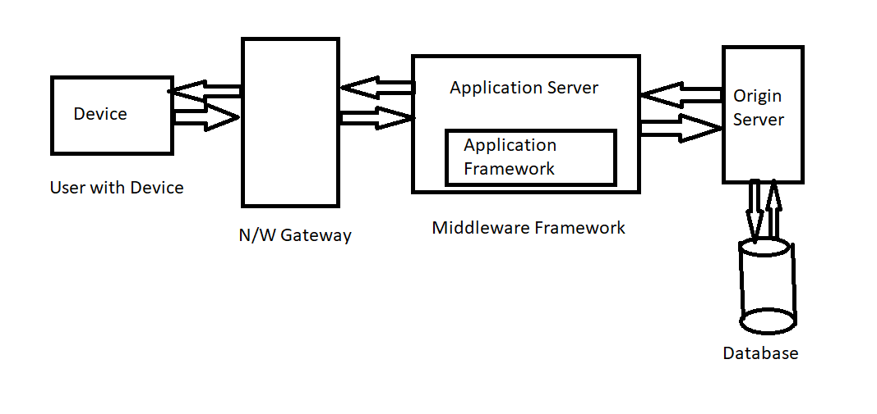
Stages of MC Functions

Slide 27
Networks in Mobile Computing
Wireline N/W
It consist of traditional landline system and it is known as PSTN (Public Switch Telephone Network).
Wireless N/W
They can be GSM, CDMA, GPRS, WLL (Wireless Local Loop N/W), LTE, A-LTE etc.
Adhoc N/W
Temporary N/W which are created to share data such as Bluetooth and Infra red which support wireless communication.

Slide 28
Review
Definition of MC
Functions of MC
Stages of MC and Segmentation stages
Types of Networks that can be used in MC.

